Slide 2
The Absurdity of Arrogance
1 Corinthians 4:6-13
Arrogance is always unwarranted!

Slide 3
We become arrogant when we forget God’s perspective (1 Corinthians 4:6-7)
God wants us to know our role (“these things”).
God wants us to follow Scriptural teaching (“what is written”).
God wants us to realize our success comes from him.
He gives us our abilities.
He gives us our personalities.
He gives us our opportunities.

Slide 4
We become arrogant when we forget God calls us to suffer (1 Corinthians 4:8-13)
The final destination of believers is to rule with God
Genesis 1:26
Daniel 7:13-14, 27
Revelation 20:4-6; 22:5
1 Corinthians 6:2-3
The current situation for believers is to suffer for God
Matthew 4:8-10
Matthew 16:21-23

Slide 5
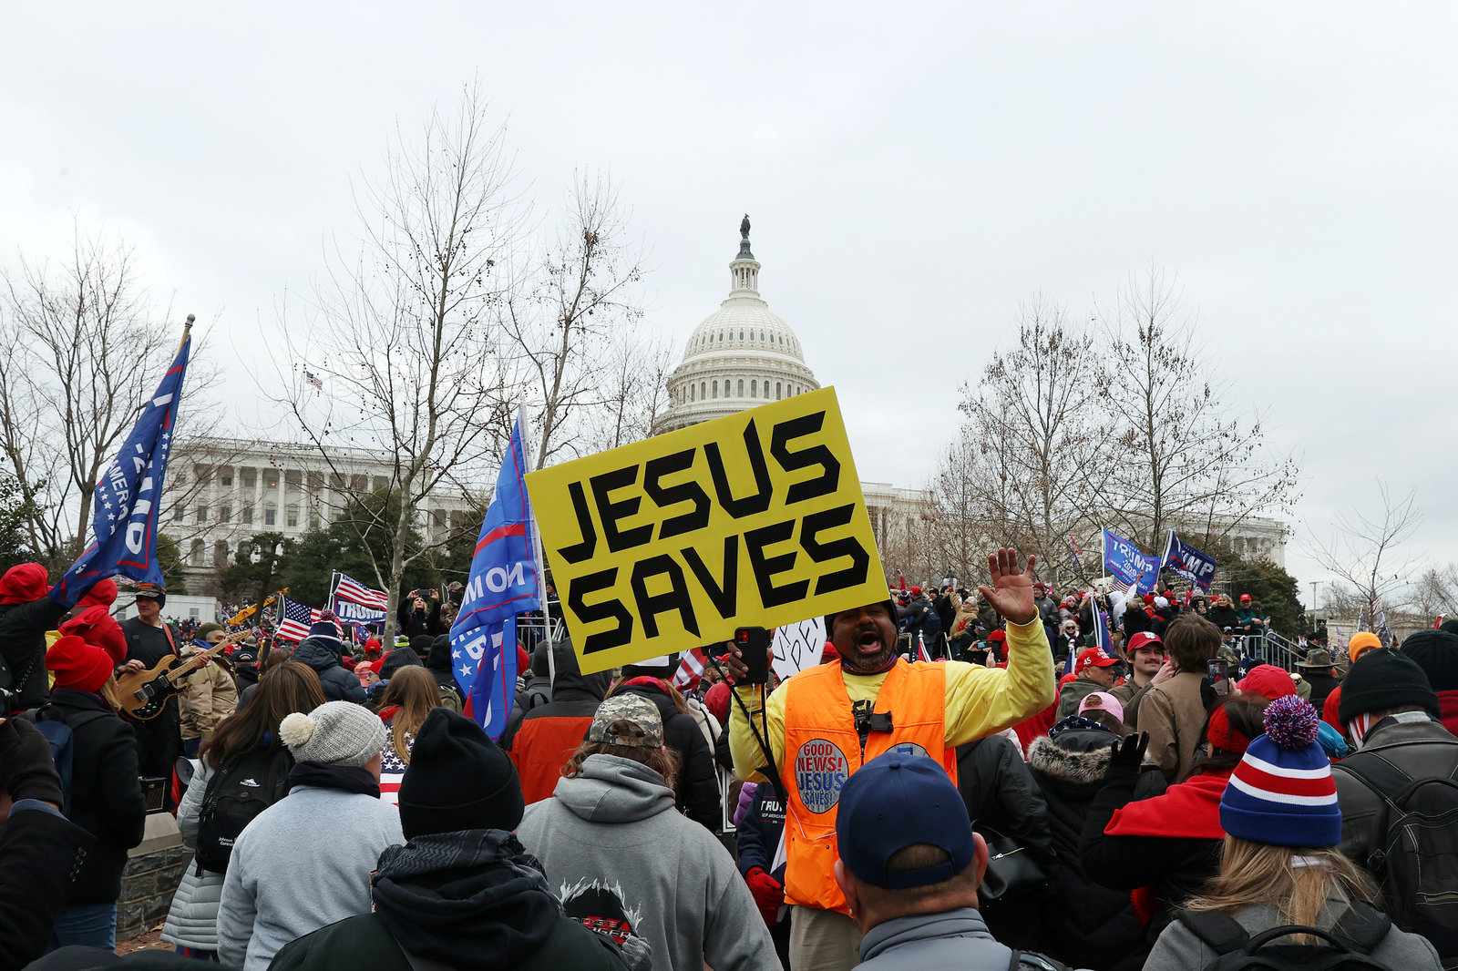

Slide 6
Biblical Principles for the Current Political Situation
Our primary allegiance is to Jesus and not to any individual nation (Philippians 3:20).
God cares about earthly nations, and we ought to as well (OT prophets, Revelation 21:24).
Secondary loves that replace primary loves are idols (Exodus 20:3; Colossians 3:5).

Slide 7
Biblical Principles for the Current Political Situation
We should not expect cultural dominance or even acceptance before Christ’s return (John 15:18-19; 1 Corinthians 4:8-13).
We can and ought to be saddened by encroaching wickedness (Matthew 5:6).
Responding with unlawful violence to the injustices around us shows a lack of faith in God (John 18:10-11).
The church most impacts the world when it seeks to obey God no matter what the world thinks, and it least impacts the world when it strives to win and keep influence in the world (1 Corinthians 1:26-31).

Slide 8
The Absurdity of Arrogance
1 Corinthians 4:6-13

